Slide 1
Data visualization (Part 1)
Prof. Yong Won SEO, Ph.D.
College of Business and Economics
Chung-Ang University

Slide 2
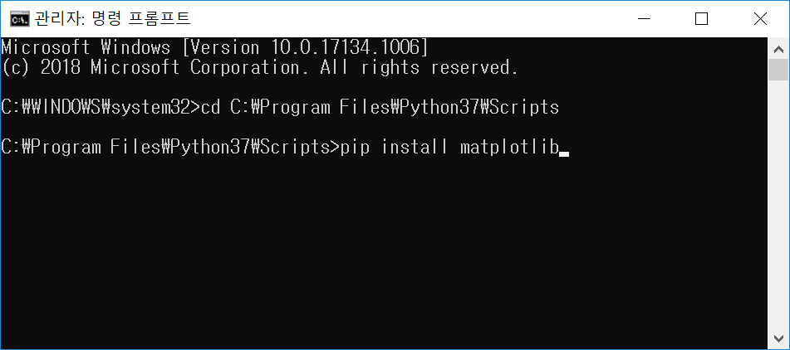
install matplotlib

Slide 3
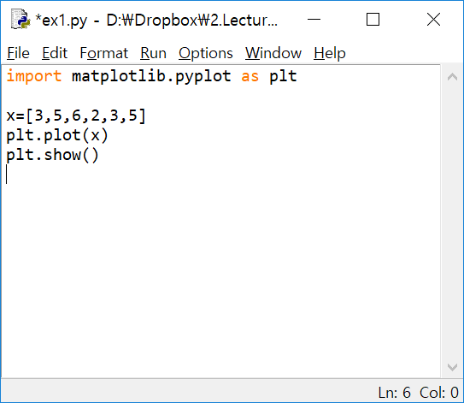
import matplotlib.pyplot and
plot something

Slide 4
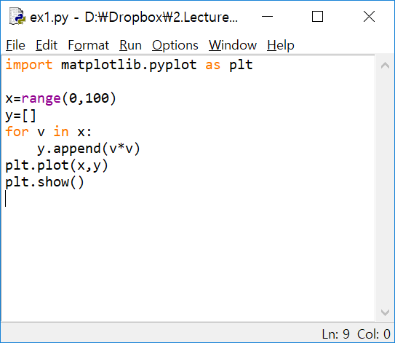
plot a graph

Slide 5
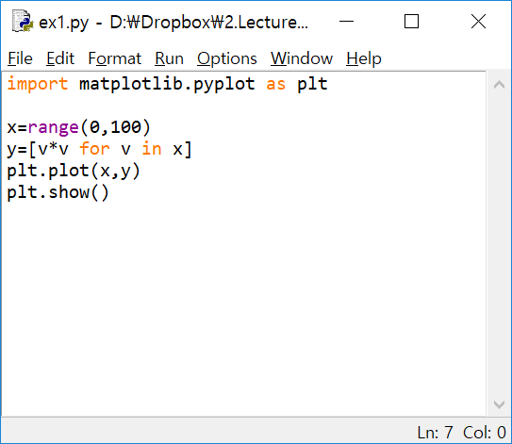
List comprehension (리스트 내장)

Slide 6
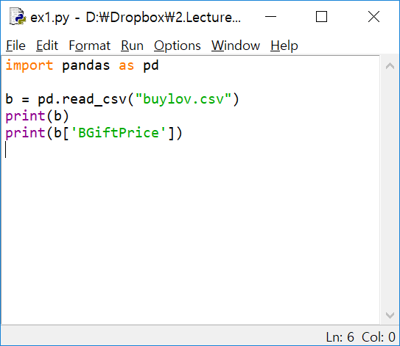
read csv file with pandas package

Slide 7
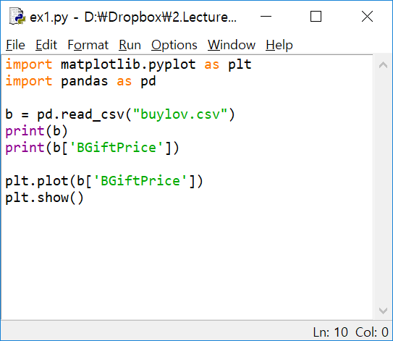
plot a column : makes little sense

Slide 8
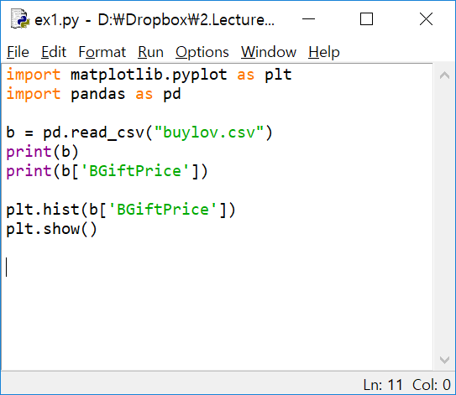
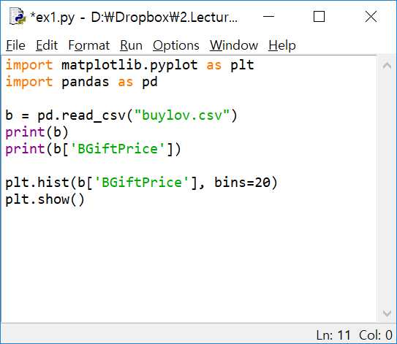
histogram

Slide 9
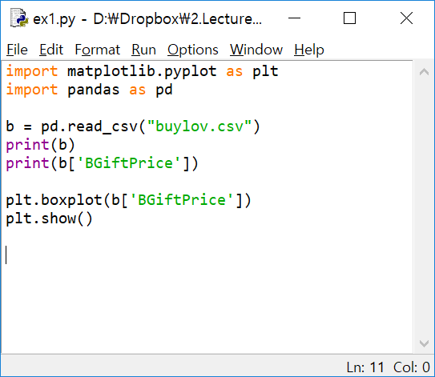
boxplot

Slide 10
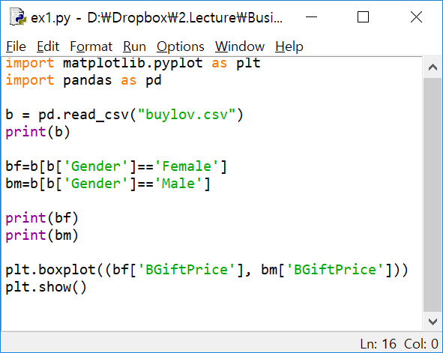
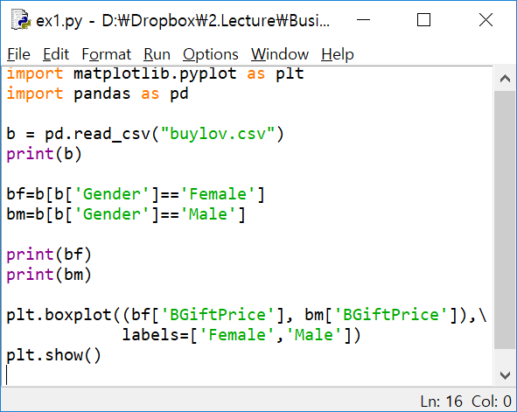
boxplot of two series

Slide 11
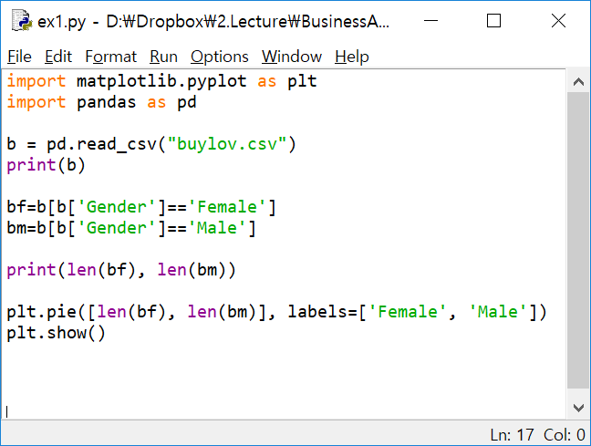
pie chart

Slide 12
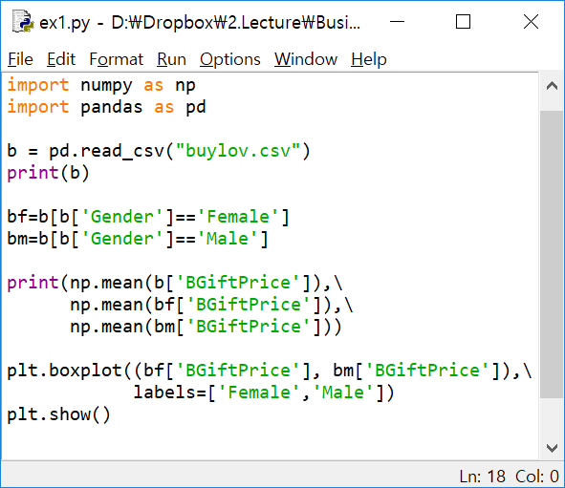
mean vs median
Expensive?

Slide 13
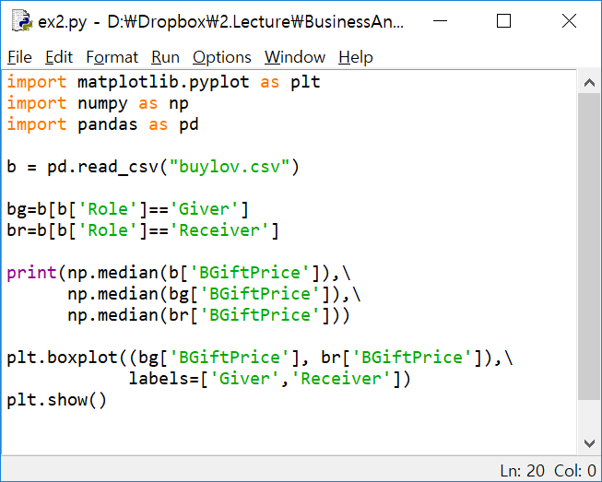
mean vs median

Slide 14
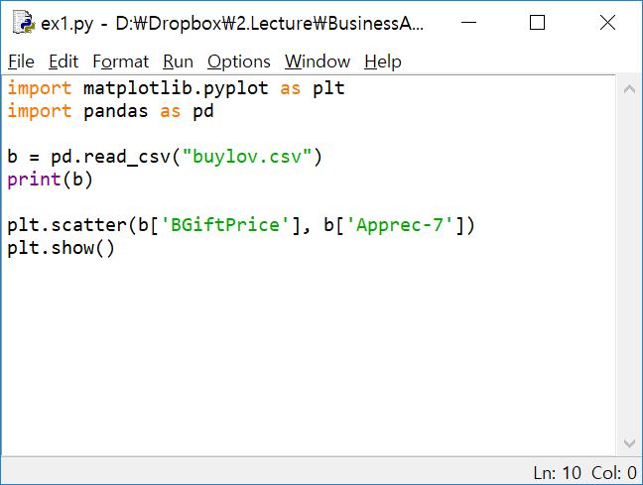
scatter plot

Slide 15
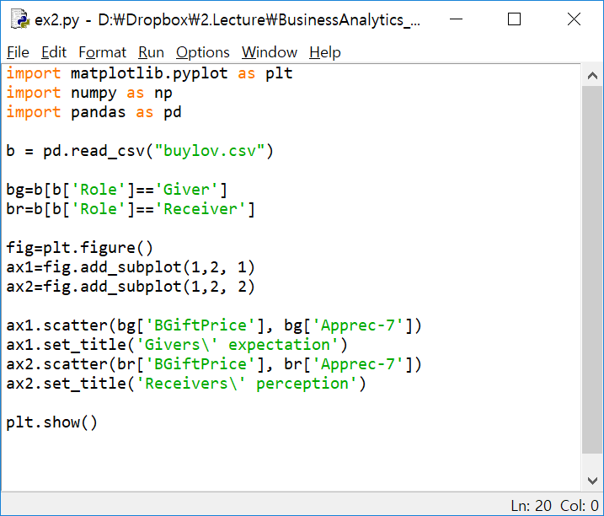
can money buy love?

